Slide 1
introducing CSCI U530 Programming Language Structures
Instructor: Dr. Chunyu Ai

Slide 2
Introduce yourself
1

Slide 3
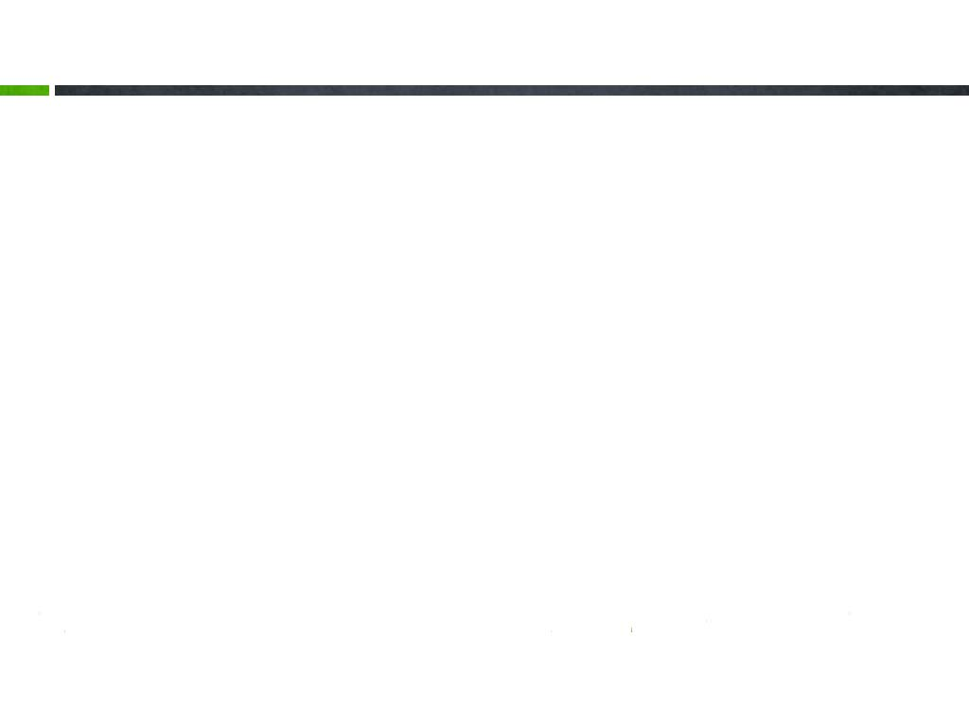
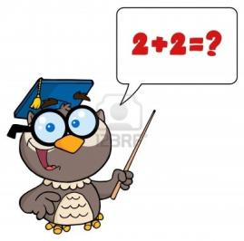

Getting Started
Dr. Chunyu Ai
http://faculty.uscupstate.edu/aic/
aic@uscupstate.edu
Hodge 218
864-503-5361
Please tell us
your name
programming languages you know
anything you want to share

Slide 4

About the class
2
Distributed and Network Programming

Slide 5

Check the syllabus for details
Midterm | 25%
Final | 25%
Quizzes | 20%
Assignments and Projects | 30%

Slide 6
?

Slide 7
Coding Challenge
Find the Missing Number
You are given a list of n-1 integers and these integers are in the range of 1 to n. There are no duplicates in list. One of the integers is missing in the list. Write an efficient code to find the missing integer.
Example : I/P [1, 2, 4 ,6, 3, 7, 8]
O/P 5

Slide 8
Coding Challenge
Find the Missing Number in a sorted array
Given a list of n-1 integers and these integers are in the range of 1 to n. There are no duplicates in list. One of the integers is missing in the list. Write an efficient code to find the missing integer.
Examples:
Input : arr[] = [1, 2, 3, 4, 6, 7, 8]
Output : 5
Input : arr[] = [1, 2, 3, 4, 5, 6, 8, 9]
Output : 7

